Slide 1
CS7/8745 : Machine Learning Instructor: Salim Sazzed Department of Computer Science University of Memphis

Slide 2
Recap

Slide 3
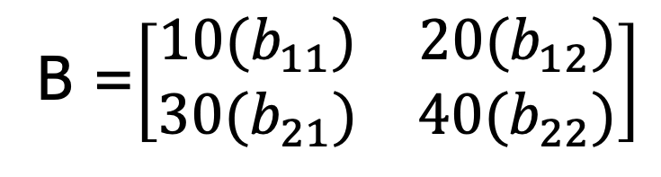
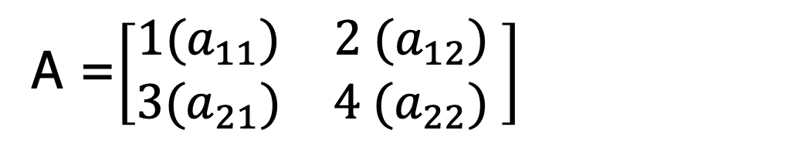
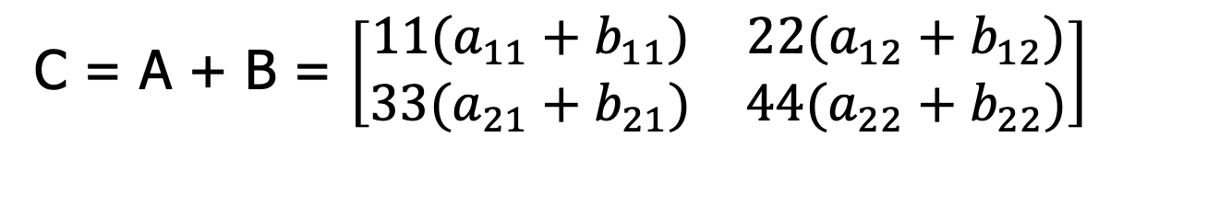
Matrix Addition:
A =$\left[\begin{matrix}1(a_{11}) & 2 (a_{12}) \\ 3(a_{21}) & 4 (a_{22})\end{matrix} \right]$
B =$\left[\begin{matrix}10(b_{11}) & 20(b_{12}) \\ 30(b_{21}) & 40(b_{22})\end{matrix}\right]$
C = A + B = $\left[\begin{matrix}11(a_{11}+b_{11}) & 22(a_{12}+b_{12}) \\ 33(a_{21}+b_{21}) & 44(a_{22}+b_{22})\end{matrix}\right]$
Size of matrices need to be same

Slide 4



Matrix Multiplication
For product C=AB to be defined,
Satisfy: No. of columns of A == No. of rows of B
– If A is of shape mxn and B is of shape nxp then
matrix product C is of shape mxp
C =AB ⇒C_{i,j} = ∑A_{i,k}B_{k,j}
k
A =$\left[\begin{matrix}2 & 1 \\ 0 & −1\end{matrix}\right]$
B =$\left[\begin{matrix}3 & 4 \\ 5 & 6\end{matrix}\right]$
We want to compute C = A * B.
The resulting matrix C will be a 2x2 matrix, and its elements will be computed as follows:
C[1][1] = (2 * 3) + (1 * 5) = 6 + 5 = 11
C[1][2] = (2 * 4) + (1 * 6) = 8 + 6 = 14
C[2][1] = (0 * 3) + (-1 * 5) = 0 - 5 = -5
C[2][2] = (0 * 4) + (-1 * 6) = 0 - 6 = -6
C =$\left[\begin{matrix}11 & 14 \\ −5 & −6\end{matrix}\right]$

Slide 5
Matrix and Vector Properties
Distributivity over addition: A(B+C)=AB+AC
Associativity: A(BC)=(AB)C
Not commutative (in general): AB!=BA
Order matters
Why not commutative?
What about addition?
Dot product between vectors is commutative:
x^{T}y=y^{T}x
Transpose of a matrix product has a simple form: (AB)^{T}=B^{T}A^{T}

Slide 6
Identity and Inverse Matrices
Matrix inversion is a powerful tool to analytically solve Ax=b
Needs concept of Identity matrix
Identity matrix does not change value of vector when we multiply the vector by identity matrix
– Denote identity matrix that preserves n-dimensional vectors as I_{n}
Formally
Example of I
⎡
⎢
⎢
1 | 0
0 | 1
0 | 0
₀ ⎤
3
₀ ⎥
⎥
⎢
1 ⎥
21
⎣
⎦

Slide 7
Determinant of A Matrix
The determinant of a matrix is a scalar value that can be calculated from the elements of the matrix.
Determinants are specifically defined for square matrices, which are matrices with an equal number of rows and columns.
Non-square matrices do not have determinants.
It has various geometric and algebraic interpretations and is used in a wide range of mathematical applications, including solving systems of linear equations, computing matrix inverses, understanding transformations, and more

Slide 8
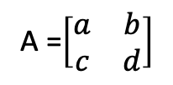
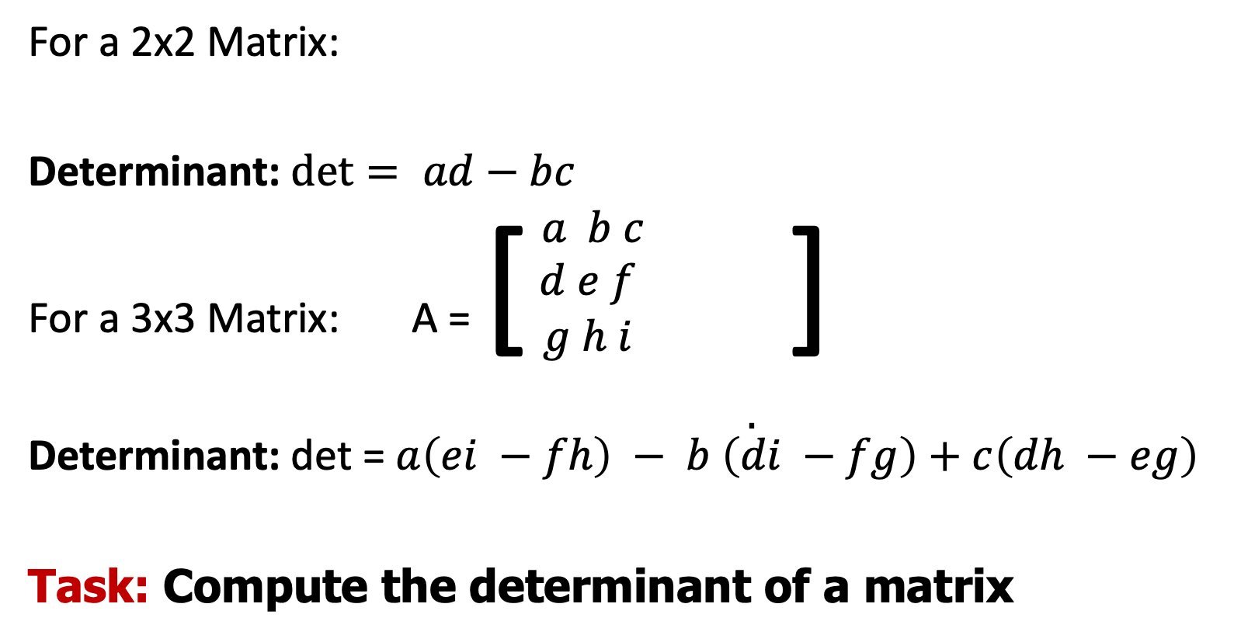
Determinant of a Matrix
For a 2x2 Matrix:
Determinant: $det= ad−bc$
For a 3x3 Matrix: A = [ $\begin{matrix}\begin{aligned}a b c \\ d e f \\ g h i \end{aligned} & & \\ & & \\ & & . \end{matrix}$]
Determinant: det = $a\left(ei −fh\right) − b \left(di −fg\right)+c\left(dh −eg\right)$
Task: Compute the determinant of a matrix
A =$\left[\begin{matrix}a & b \\ c & d\end{matrix}\right]$

Slide 9
Inverse of A matrix
The inverse of a square matrix is another matrix that, when multiplied with the original matrix, yields the identity matrix of the same size.
In other words, if A is a square matrix and A⁻¹ is its inverse, then:
A A⁻¹ = A⁻¹ A = I
Where I is the identity matrix. The identity matrix is a special matrix that has ones on its main diagonal and zeros elsewhere.
Not all square matrices have inverses. For a matrix to be invertible (or non-singular), its determinant must be non-zero. If the determinant is zero, the matrix is singular, and it does not have an inverse.
For larger matrices, finding the inverse can be more involved and might require methods such as Gaussian elimination or using the adjugate matrix.
The concept of matrix inverses is crucial in various mathematical applications and fields, such as solving systems of linear equations, calculating transformations, and solving problems in physics, engineering, and computer graphics.

Slide 10

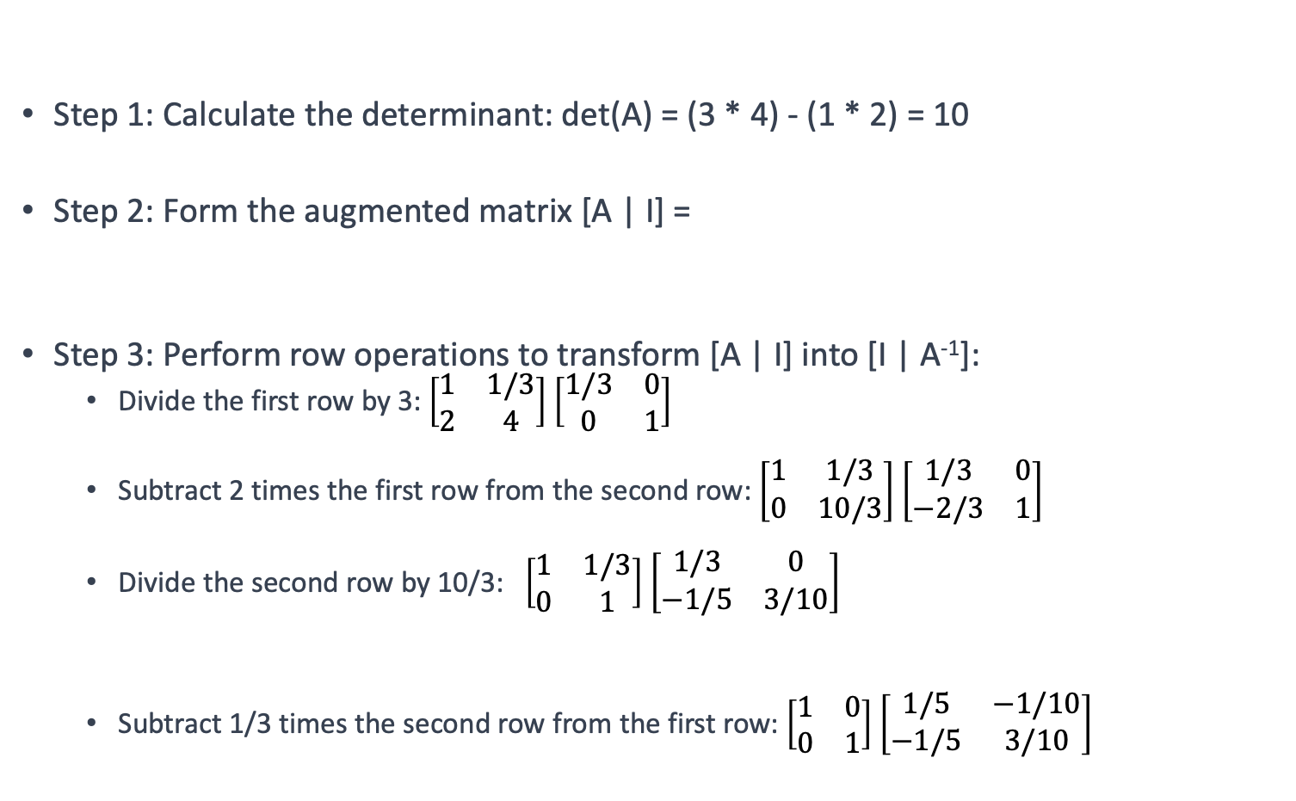

Compute inverse of the following matrix -
Gauss-Jordan method
A =$\left[\begin{matrix}3 & 1 \\ 2 & 4\end{matrix}\right]$
Step 1: Calculate the determinant: det(A) = (3 * 4) - (1 * 2) = 10
Step 2: Form the augmented matrix [A | I] =
Step 3: Perform row operations to transform [A | I] into [I | A⁻¹]:
Divide the first row by 3: $\left[\begin{matrix}1 & 1/3 \\ 2 & 4\end{matrix}\right]$ $\left[\begin{matrix}1/3 & 0 \\ 0 & 1\end{matrix}\right]$
Subtract 2 times the first row from the second row: $\left[\begin{matrix}1 & 1/3 \\ 0 & 10/3\end{matrix}\right]$ $\left[\begin{matrix}1/3 & 0 \\ −2/3 & 1\end{matrix}\right]$
Divide the second row by 10/3: $\left[\begin{matrix}1 & 1/3 \\ 0 & 1\end{matrix}\right]$ $\left[\begin{matrix}1/3 & 0 \\ −1/5 & 3/10\end{matrix}\right]$
Subtract 1/3 times the second row from the first row: $\left[\begin{matrix}1 & 0 \\ 0 & 1\end{matrix}\right]$ $\left[\begin{matrix}1/5 & −1/10 \\ −1/5 & 3/10\end{matrix}\right]$
$\left[\begin{matrix}3 & 1 \\ 2 & 4\end{matrix}\right]$ $\left[\begin{matrix}1 & 0 \\ 0 & 1\end{matrix}\right]$
https://www.mathsisfun.com/algebra/matrix-inverse-row-operations-gauss-jordan.html

Slide 11
Allowed Operations
Row Replacement (or Row Substitution):
Replace Row j with Row j - k * Row i, where k is a scalar.
Row Scaling (or Scalar Multiplication):
Multiply Row j by a nonzero scalar k.
Row Interchange (Row Swapping):
Swap Row i and Row j.

Slide 12
A =$\left[\begin{matrix}2 & 3 \\ 4 & 5\end{matrix}\right]$ , what will be A⁻¹

Slide 13

Answer: A =$\left[\begin{matrix}0 & 1/2 \\ 1 & −1/2\end{matrix}\right]$

Slide 14
Probability

Slide 15
Probability is a fundamental concept in mathematics and statistics that measures the likelihood of an event occurring.
It quantifies the uncertainty or randomness associated with various outcomes in a given situation.
In simpler terms, probability answers the question: "How likely is it that something will happen?”

Slide 16
Sample Space: It represents every possible result that could occur in a given situation. For example, when rolling a six-sided die, the sample space consists of the numbers 1 through 6.
It represents the complete set of potential results that can occur when an experiment is performed.
Event: An event is a specific outcome or a collection of outcomes from the sample space. Events can range from simple, like rolling a 4 on a die.
Probability Measure: Probability assigns a numerical value to each event, representing the likelihood of that event occurring.
Probabilities are typically expressed as numbers between 0 and 1, where 0 indicates that an event is impossible, 1 indicates that an event is certain, and values in between represent varying degrees of likelihood.

Slide 17
Probability Calculation: The probability of an event A, denoted as P(A), is calculated as the ratio of the number of favorable outcomes (those in event A) to the total number of possible outcomes in the sample space.
Mathematically, it's often expressed as:
P(A) = Number of Favorable Outcomes / Total Number of Possible Outcomes

Slide 18
Rolling a Fair Six-Sided Die:
Sample Space: {1, 2, 3, 4, 5, 6}.
Event: Rolling an even number (2, 4, or 6).
Number of Favorable Outcomes: 3 (2, 4, 6).
Total Number of Possible Outcomes: 6.
Probability: P(Even number) = 3/6 = 1/2 = 0.5 (50%).
2. Drawing Cards from a Deck of Playing Cards:
Event: Drawing a red card (hearts or diamonds).
Sample Space: 52 cards in a standard deck.
Number of Favorable Outcomes: 26 (13 hearts + 13 diamonds).
Total Number of Possible Outcomes: 52.
Probability: P(Red card) = 26/52 = 1/2 = 0.5 (50%).
Quiz: Drawing a green marble from a bag with 4 green, 3 red, and 2 blue marbles.

Slide 19
Event: Drawing a green marble from a bag with 4 green, 3 red, and 2 blue marbles.
Sample Space: {Green, Red, Blue}.
Number of Favorable Outcomes: 4 (green marbles).
Total Number of Possible Outcomes: 9.
Probability: P(Green) = 4/9.

Slide 20
Bayesian Statistics
Bayesian methods are widely used in various fields such as machine learning, data analysis, biology, economics, and more.
Offering a flexible and powerful approach to handling uncertainty and making informed decisions.

Slide 21
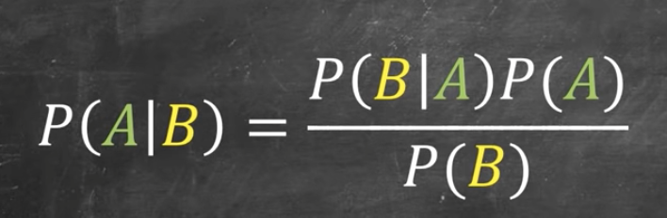
Bayesian Statistics
At the core of Bayesian statistics is Bayes' theorem, which relates conditional probabilities of events. Lets consider two events A and B.
Conditional Probability: P(A∣B) is the probability of event A given event B.
https://www.youtube.com/watch?v=ibINrxJLvlM

Slide 22
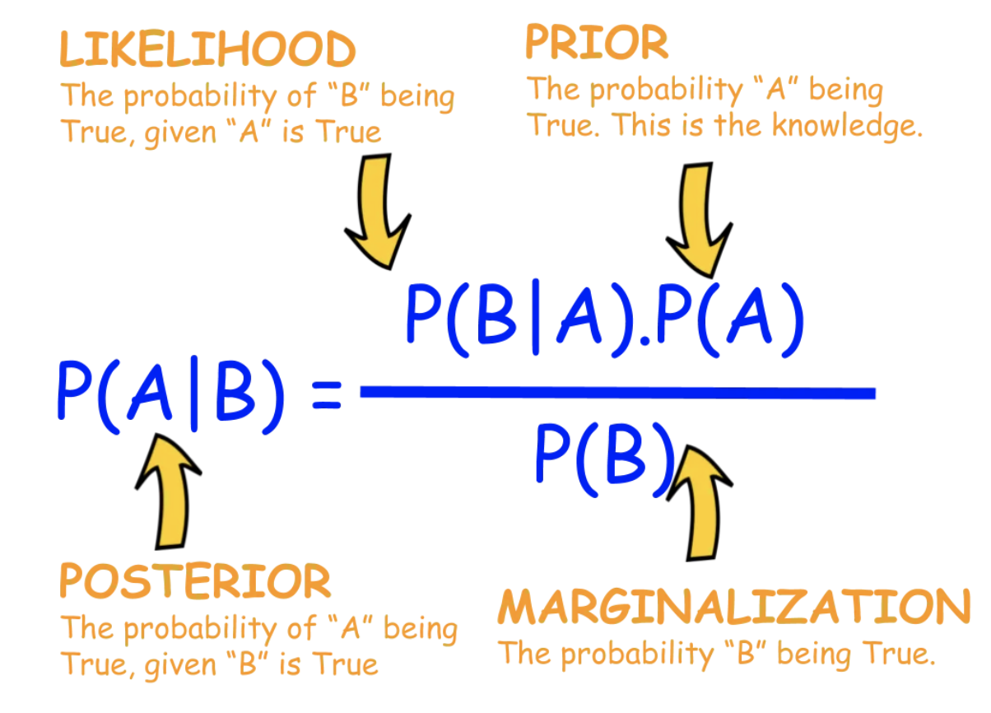
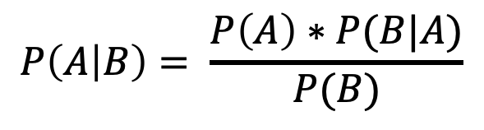
$$P\left(A | B\right)= \frac{P\left(A\right)∗P(B|A)}{P(B)}$$
P(A∣B) is the probability of hypothesis A being true given observed data B (this is called the posterior probability).
P(B∣A) is the probability of observing the data B given that hypothesis A is true (this is called the likelihood).
P(A) is the prior probability of hypothesis A being true before considering the data
P(B) is the probability of observing the data B, which can be thought of as a normalizing constant.
https://www.youtube.com/watch?v=XQoLVl31ZfQ

Slide 23
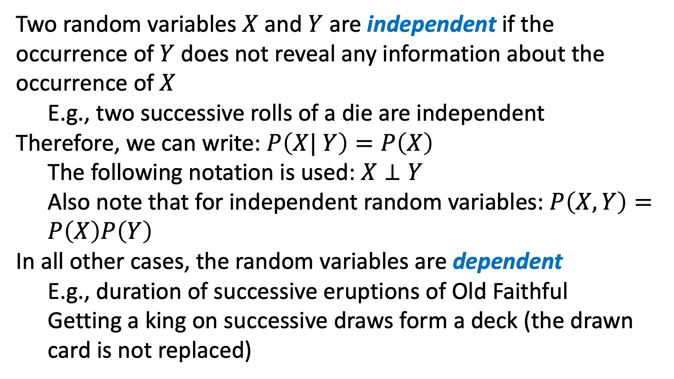
Two random variables $X$ and $Y$ are independent if the occurrence of $Y$ does not reveal any information about the occurrence of $X$
E.g., two successive rolls of a die are independent
Therefore, we can write: $P\left(X| Y\right)=P\left(X\right)$
The following notation is used: $X⊥Y$
Also note that for independent random variables: $P\left(X,Y\right)=P\left(X\right)P\left(Y\right)$
In all other cases, the random variables are dependent
E.g., duration of successive eruptions of Old Faithful
Getting a king on successive draws form a deck (the drawn card is not replaced)
Slide credit: Jeff Howbert — Machine Learning Math Essentials

Slide 24
Variance is a statistical measure that quantifies the spread or dispersion of a set of data points in a dataset.
It provides a way to understand how individual data points differ from the mean (average) of the dataset

Slide 25
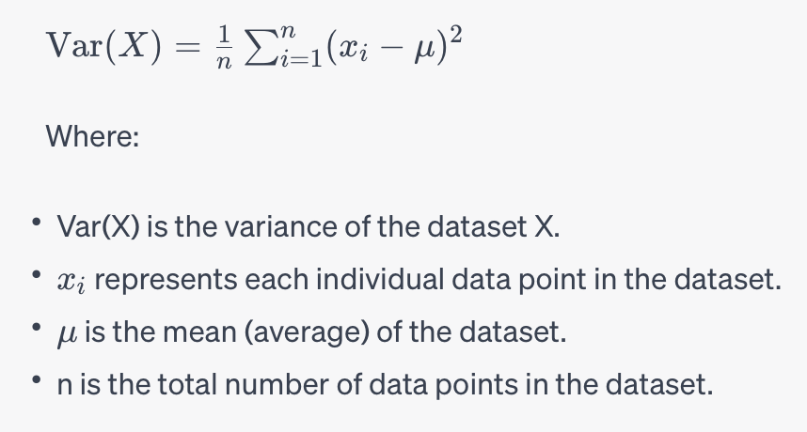
Here's how you calculate the variance of a dataset:
Calculate the mean (average) of the dataset.
For each data point, subtract the mean from that data point.
Square the result of each subtraction.
Calculate the average of these squared differences.
Mathematically, the formula for variance (denoted as Var) is as
X={85,90,88,92,78}

Slide 26
Answer : 24.056
Variance is always non-negative; it cannot be negative because it measures squared differences.
A small variance indicates that the data points are close to the mean, and the dataset is less spread out.
A large variance indicates that the data points are more spread out from the mean, suggesting greater variability in the dataset.
Variance is sensitive to outliers, as even a single extreme data point can significantly affect the variance value.
Variance is a fundamental concept in statistics and is used in various statistical analyses and calculations, including the calculation of standard deviation (the square root of variance), analysis of data distribution, and in hypothesis testing.
24.056.

